Slide 1
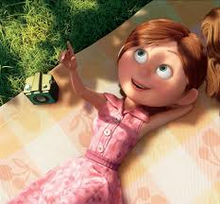
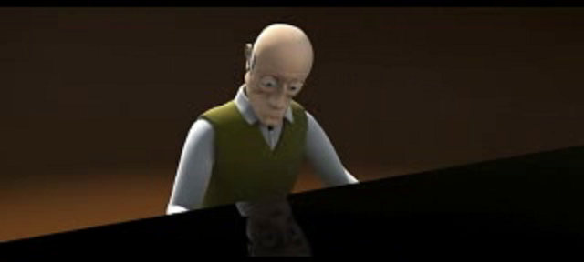
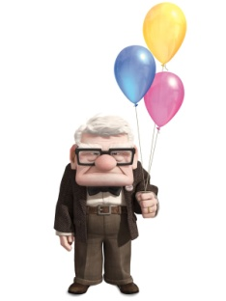

Odd one out
……………..is the odd one out because ……….
Whereas the others ………………..
Butterflies in my stomach. | A frog in my throat. | My heart is in my mouth.

